Slide 1
Case Study: USP RS Sales Analysis
By Andrey Uuemaa

Slide 2
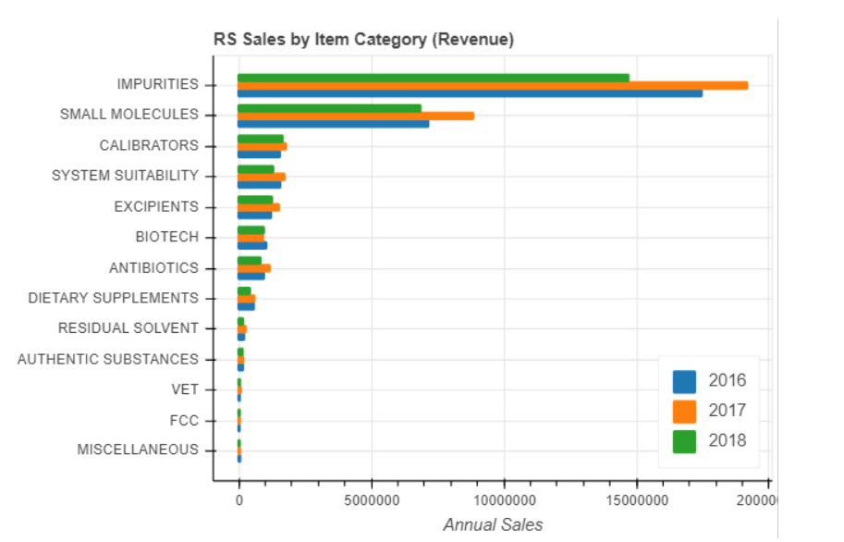
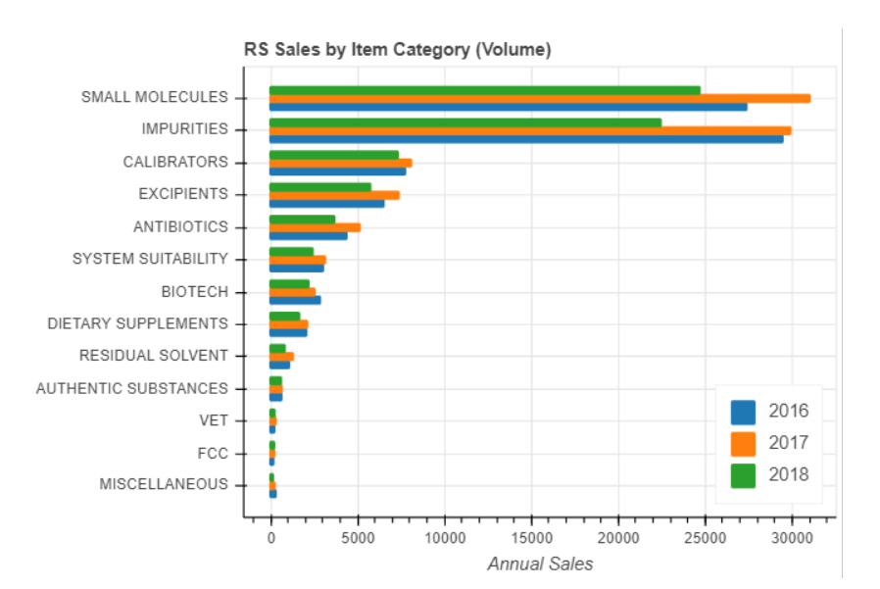
RS Sales Trends
Impurities and Small Molecules take up the most of the sales
Only 3 quarters of 2018 Fiscal Year presented

Slide 3
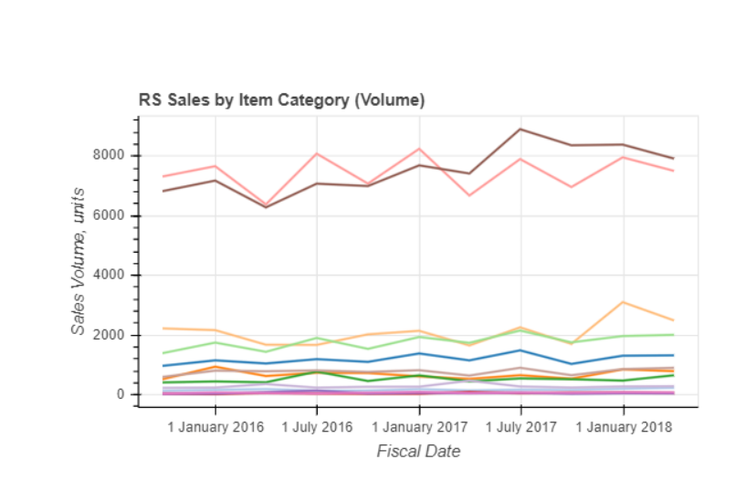
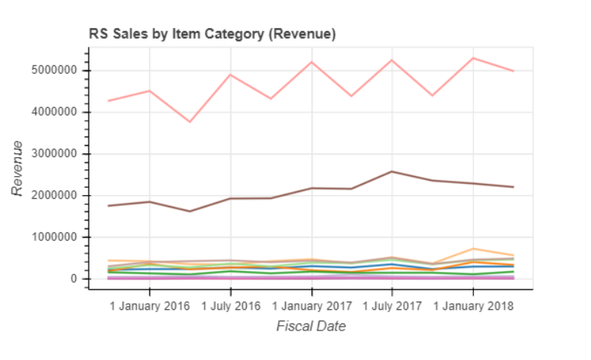

RS Sales Trends
Seasonality
General Growth Trend

Slide 4
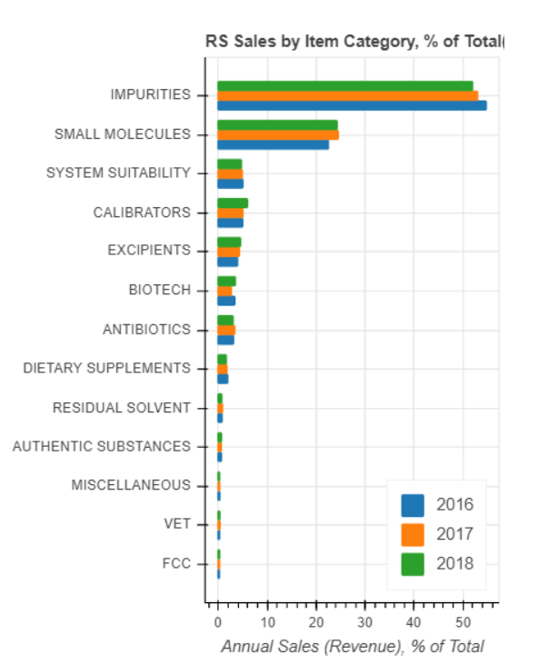
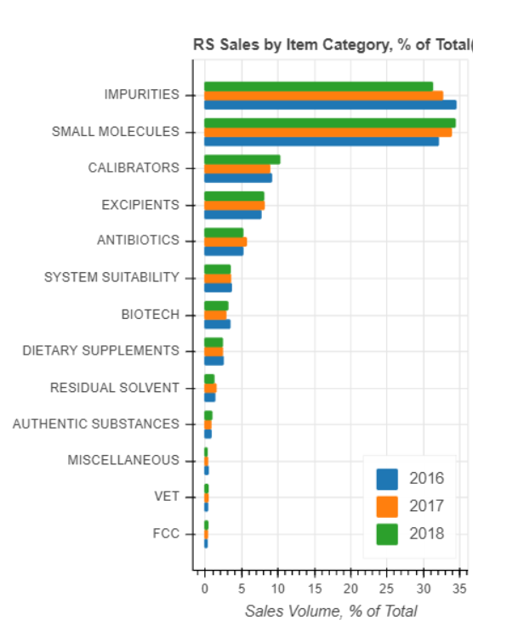
RS Sales Trends
Impurities and Small Molecules account for 70- 75% of total sales
Impurities losing ground
Small Molecules growing

Slide 5
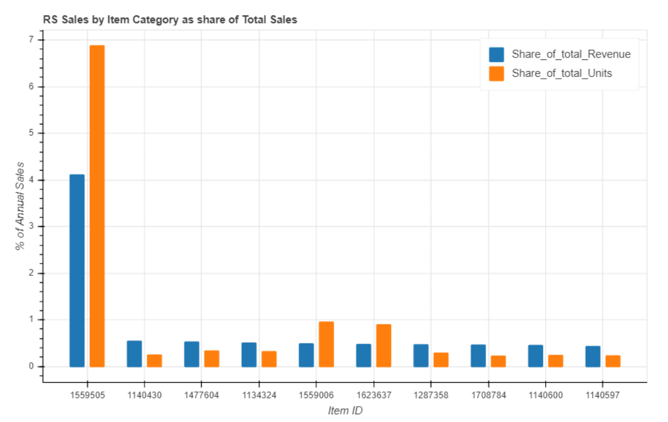
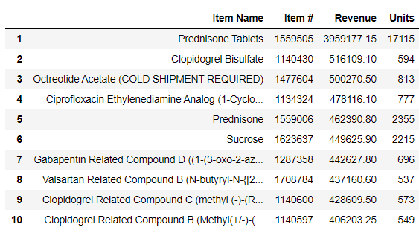
Individual Items: Top-10 by Sales
The leader of the list - Prednisone Tablets (7% by volume and 4% by revenue)
No other RS item reached sales of over 1% of total

Slide 6
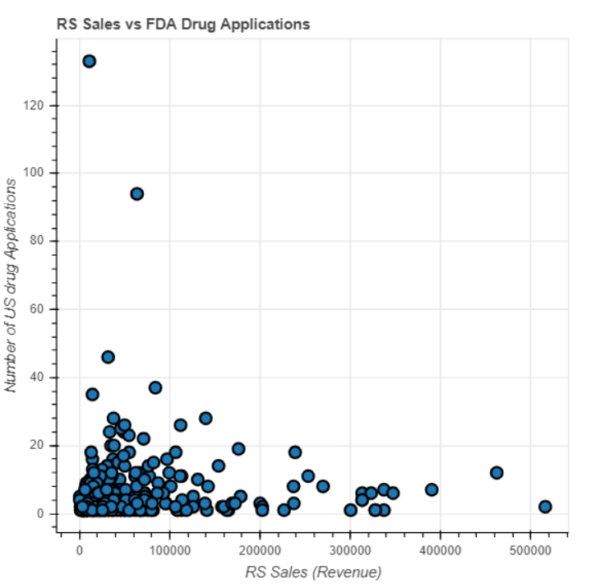
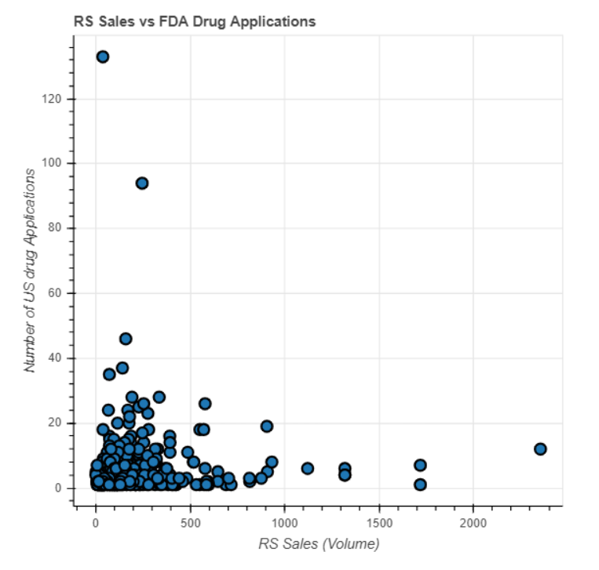
RS Sales vs FDA Drug Applications
No relationship found between RS Sales and drug applications in a given period

